Slide 1
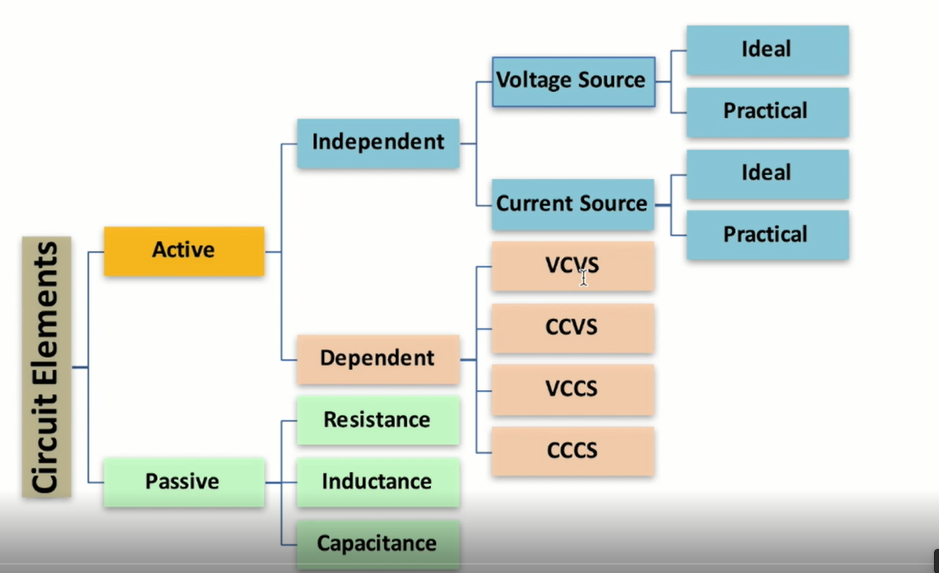

Slide 2
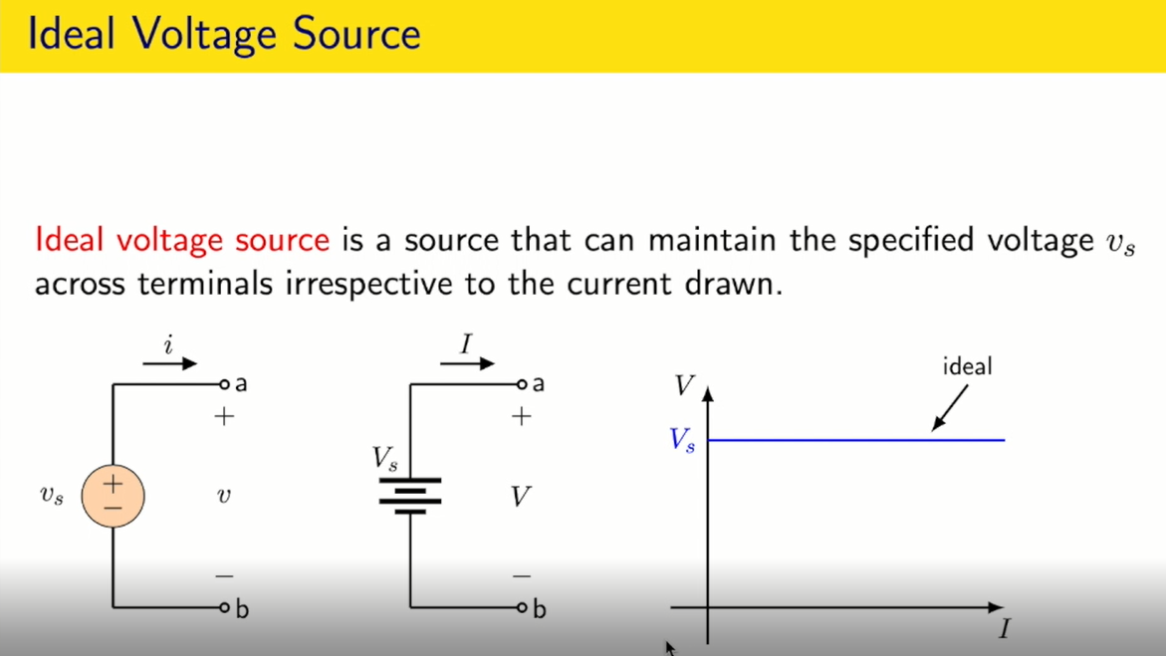

Slide 3
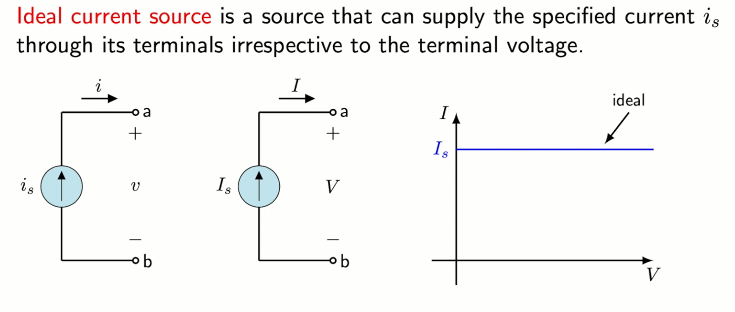

Slide 4
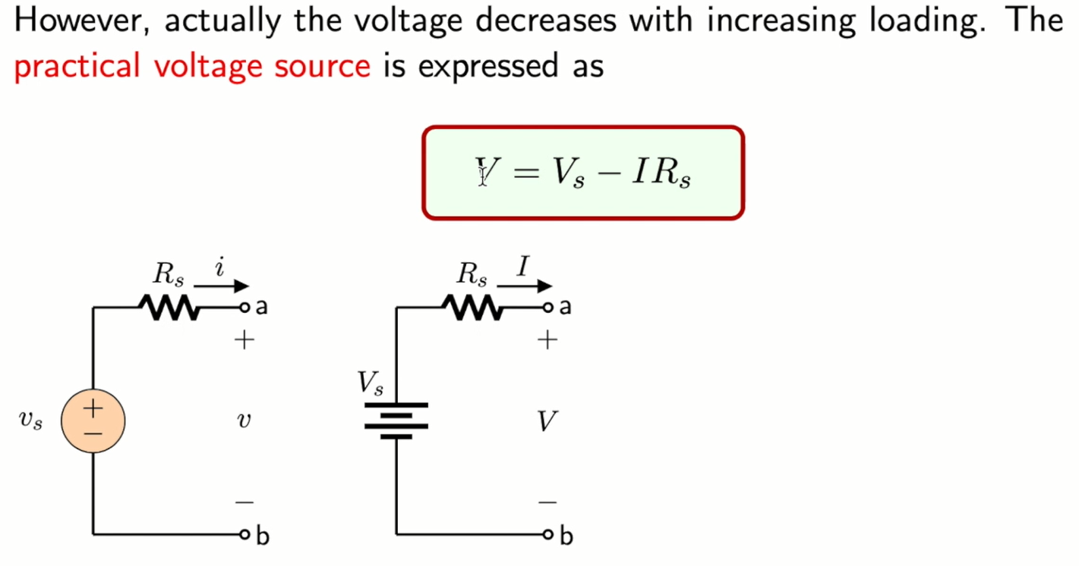

Slide 5
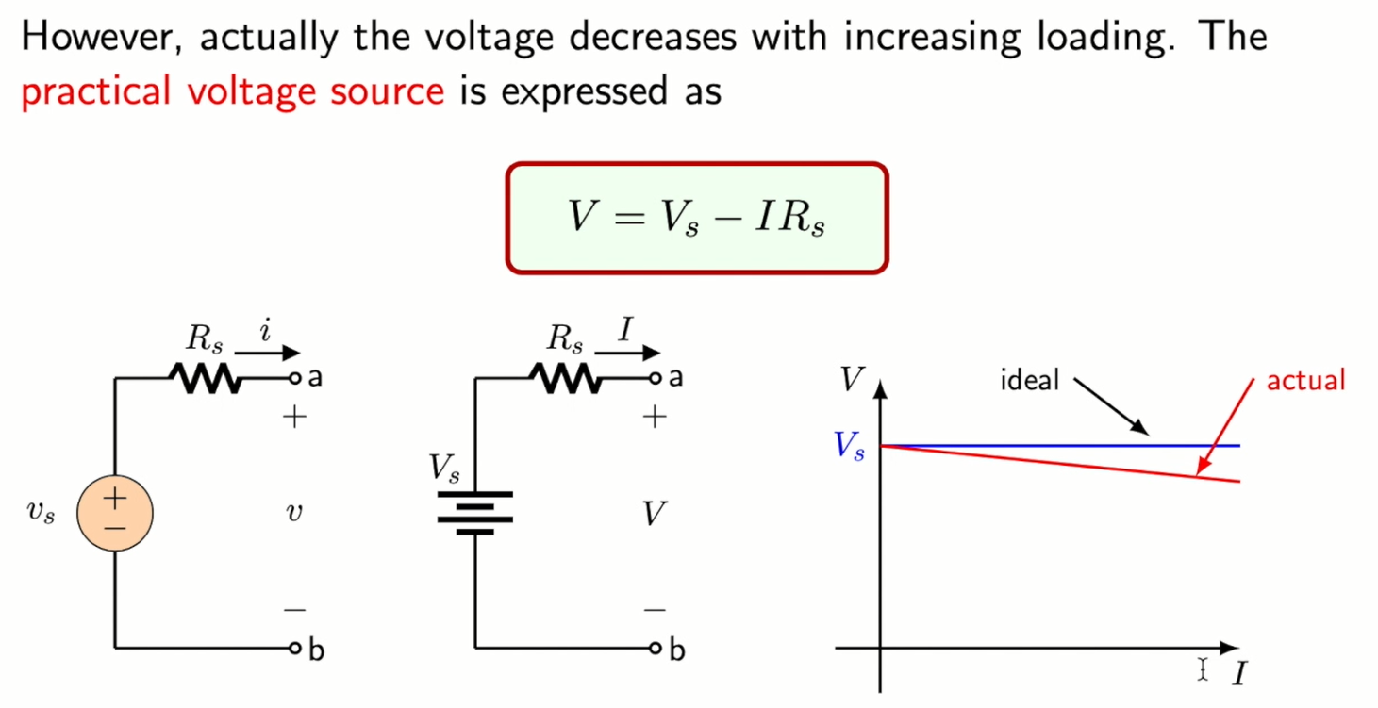

Slide 6
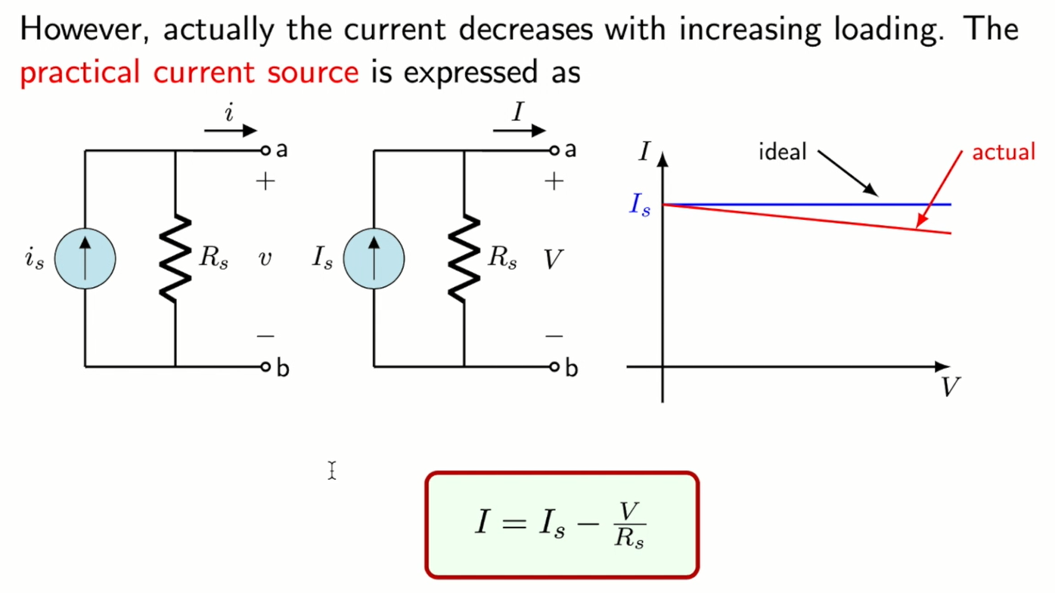

Slide 7
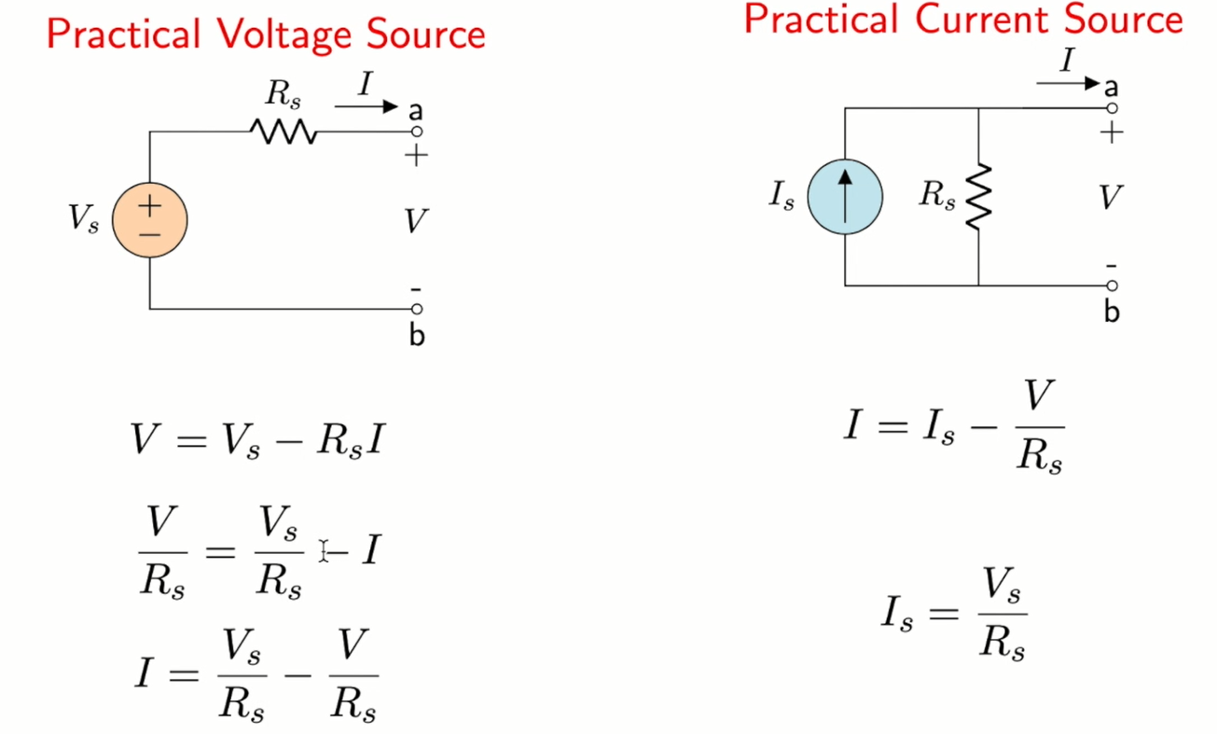

Slide 8
Dependent Sources

Slide 9
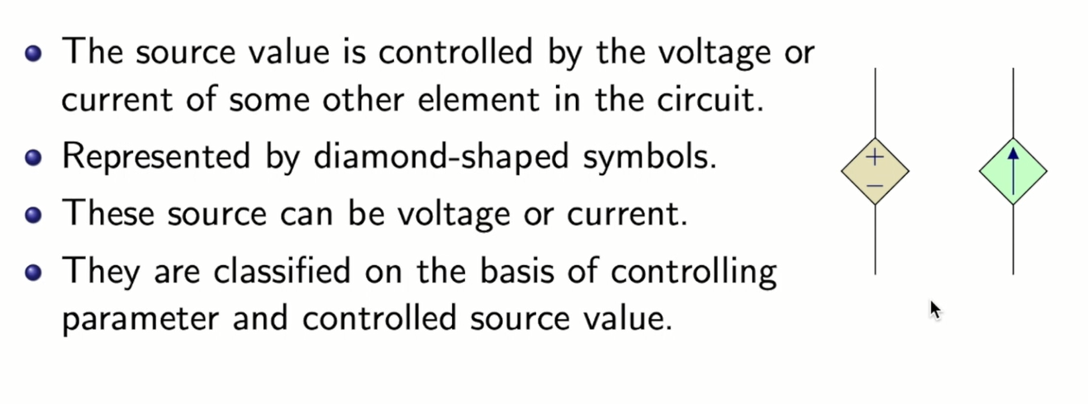

Slide 10
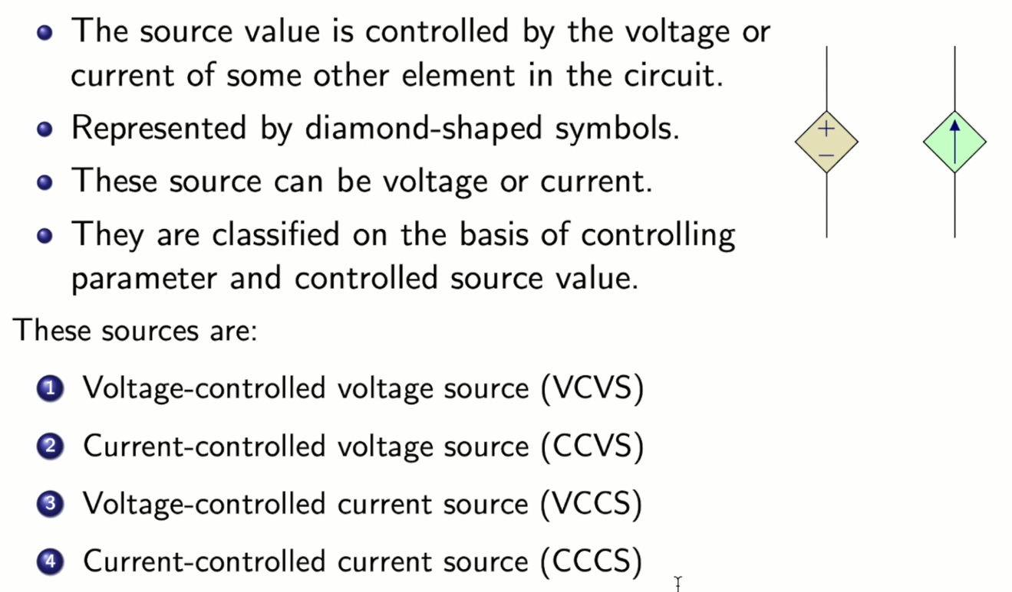

Slide 11
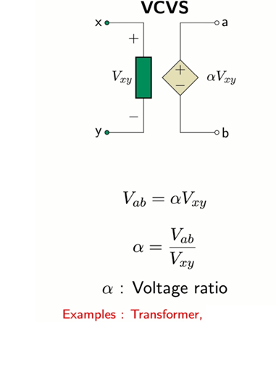

Slide 12
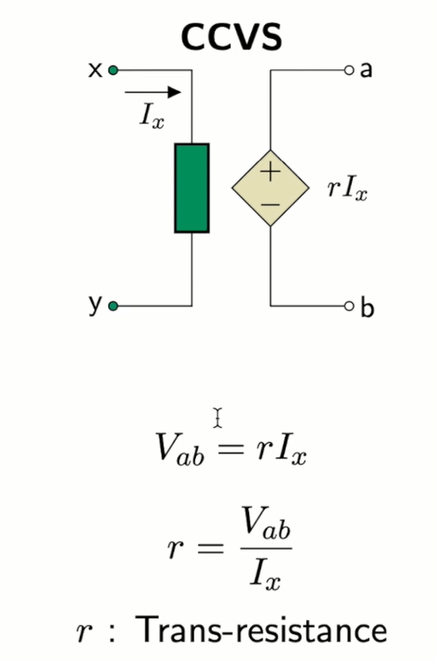

Slide 13
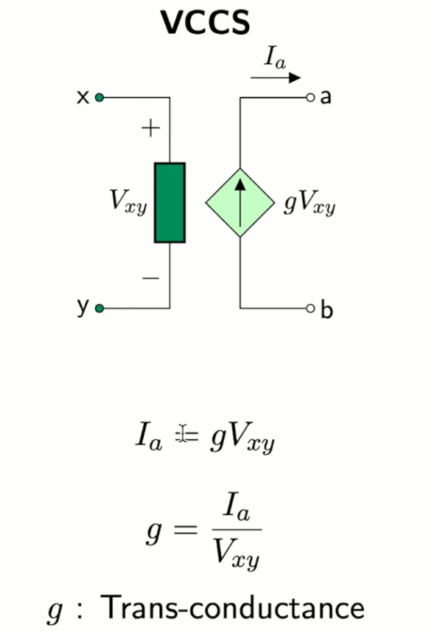

Slide 14
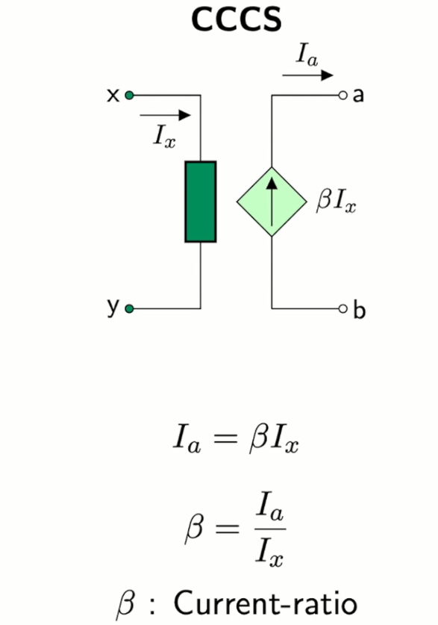

Slide 15
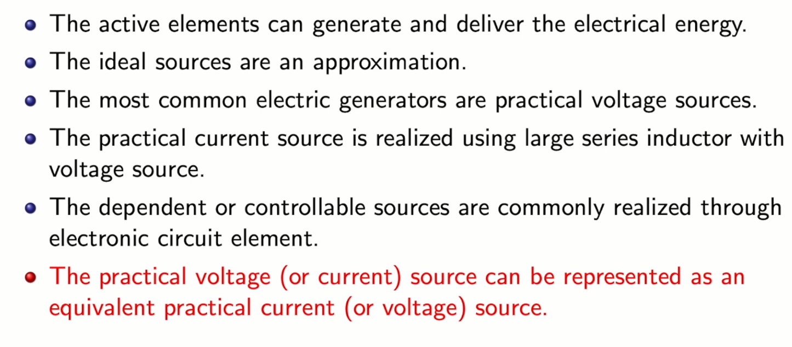

Slide 16
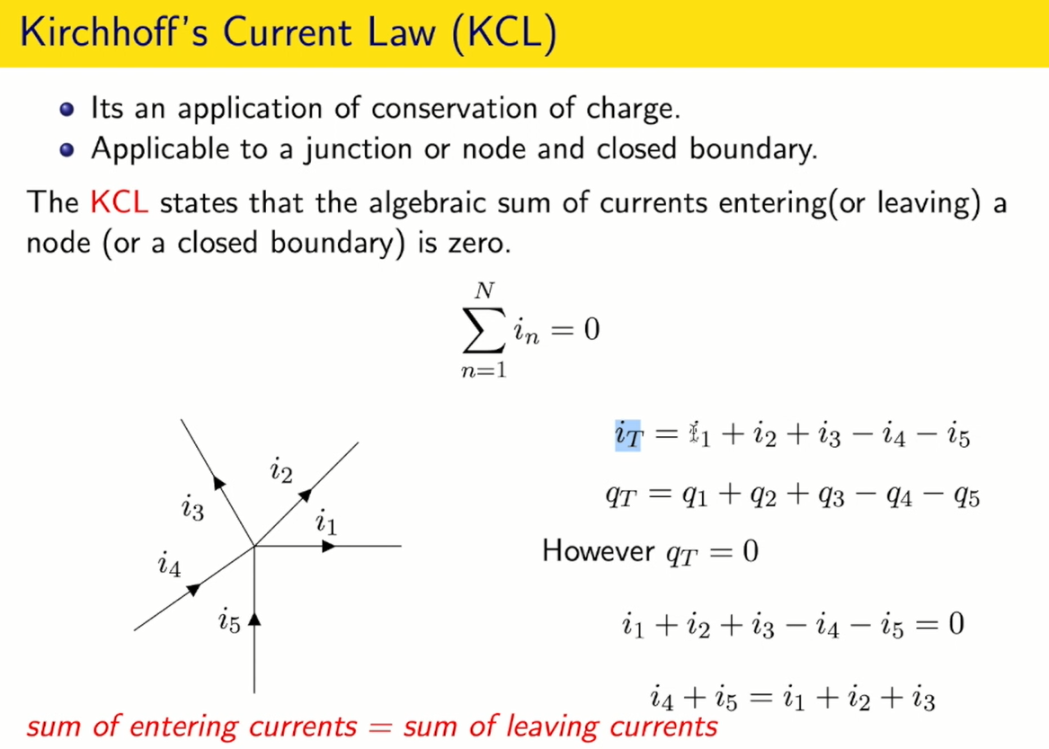

Slide 17
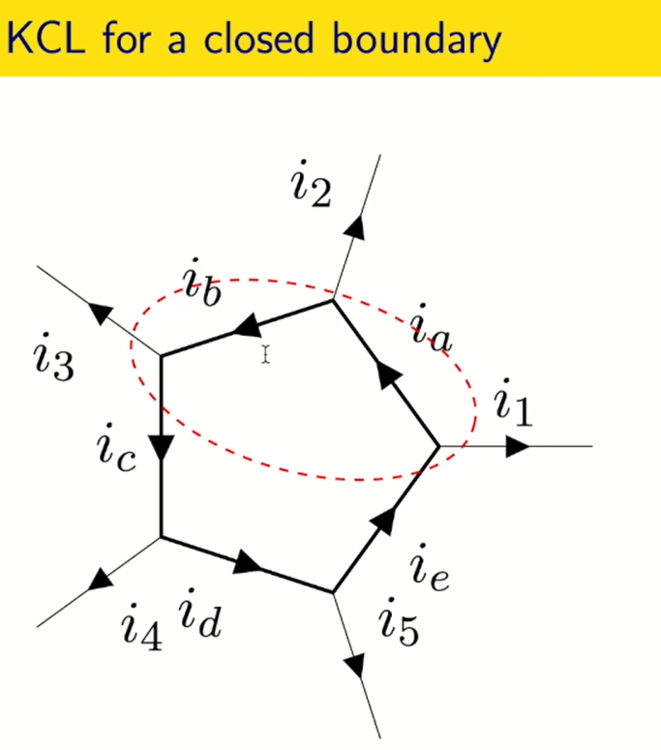

Slide 18
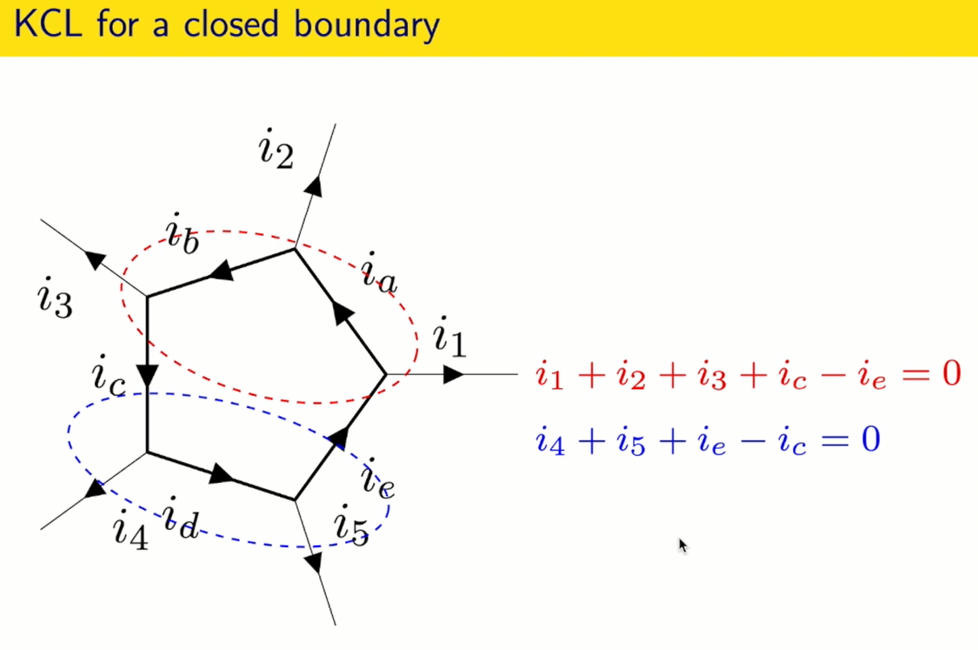

Slide 19
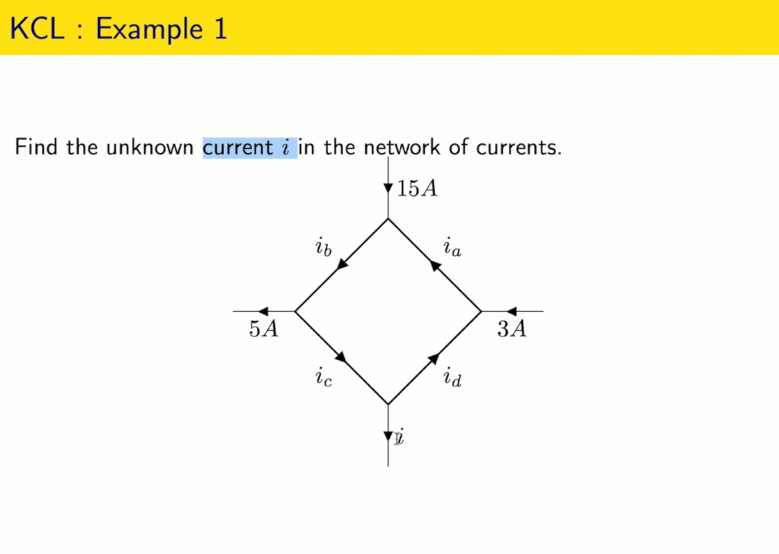

Slide 20
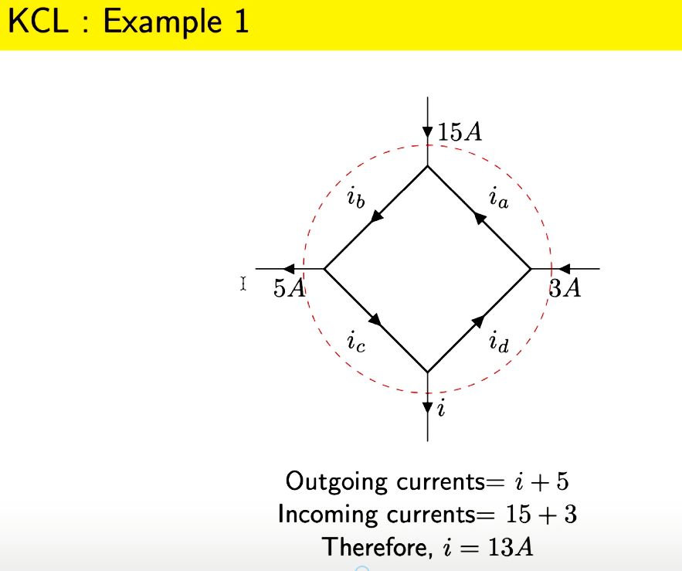

Slide 21
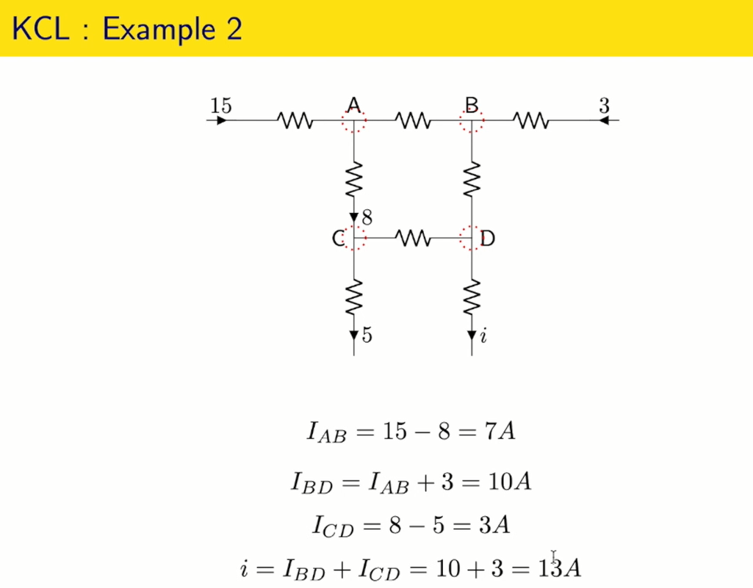

Slide 22
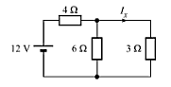
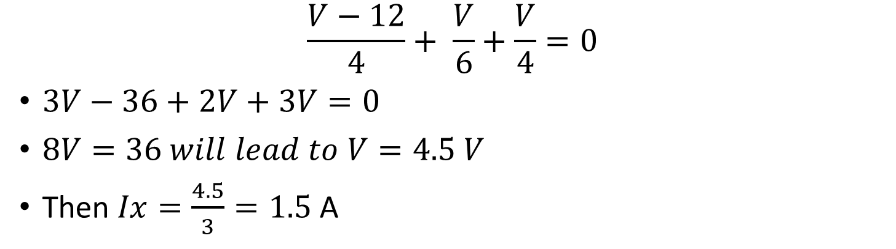
Example (KCL)
$$\frac{V−12}{4}+ \frac{V}{6}+\frac{V}{4}=0$$
$3V−36+2V+3V=0$
$8V=36 will lead to V=4.5 V$
Then $Ix=\frac{4.5}{3}=1.5$ A

Slide 23
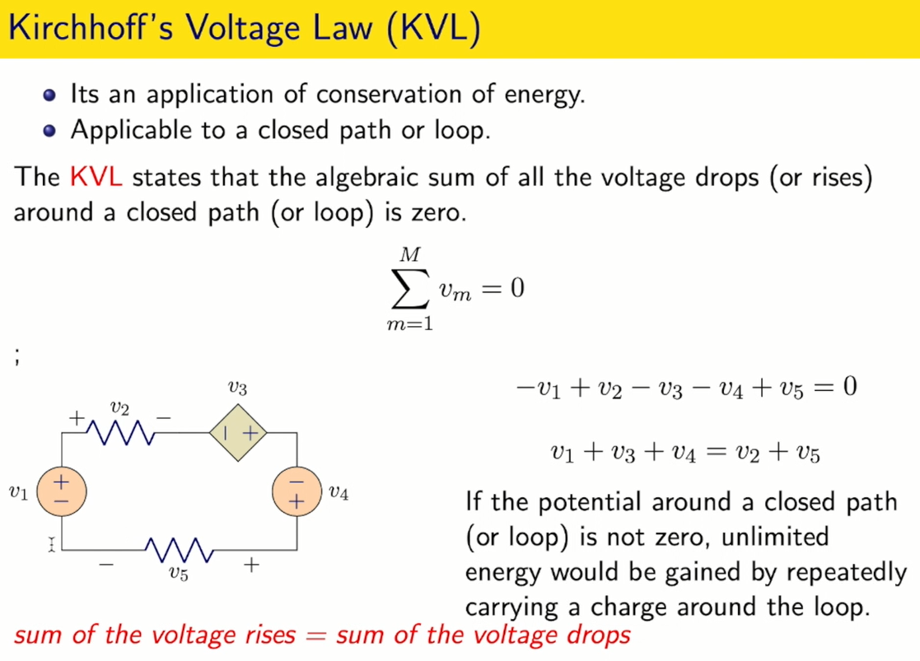

Slide 24
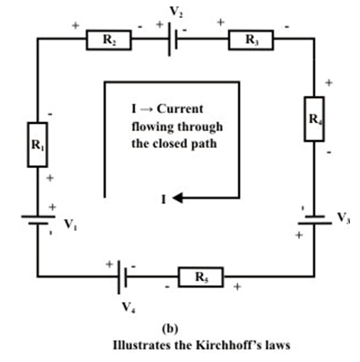
Kirchhoff's Voltage Law (KVL)
-V₁ +I.R₁ +I.R₂ + V₂ + I.R₃ + I.R₄ -V₃ + I.R₅ -V₄ = 0
OR
+V₁ -I.R₁ -I.R₂ - V₂ - I.R₃ - I.R₄ +V₃ - I.R₅ +V₄ = 0

Slide 26
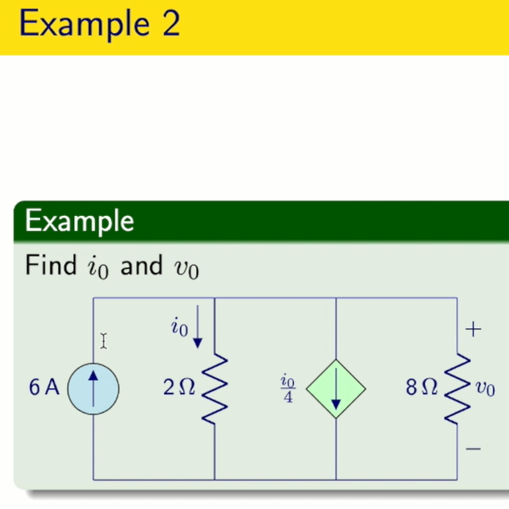
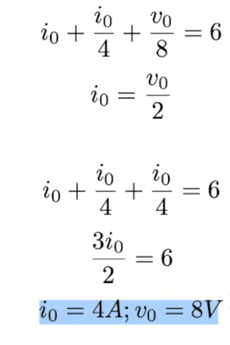

Slide 27
